Slide 1

ENTERPRISE SOFTWARE DEVELOPMENT
Notes:
if possible, SQL Server Management Studio should be 25% bigger

Slide 2

Top Database Performance Techniques
../NEW, May, 2024

Slide 3



Bryden Oliver
SSW Solution Architect
http://www.linkedin.com/in/brydenoliver
https://github.com/brydeno
20 years experience in database performance
42 years of coding
Worked with Azure since its launch
Knows about Azure at scale
Ask me about Cosmos DB

Slide 4
BRISBANE
DATA, POWER BI & AI BOOTCAMP
THANK YOU TO ALL THE SPONSORS
GOLD SPONSORS
STANDARD SPONSORS
6TH ANNUAL CONFERENCE

Slide 5
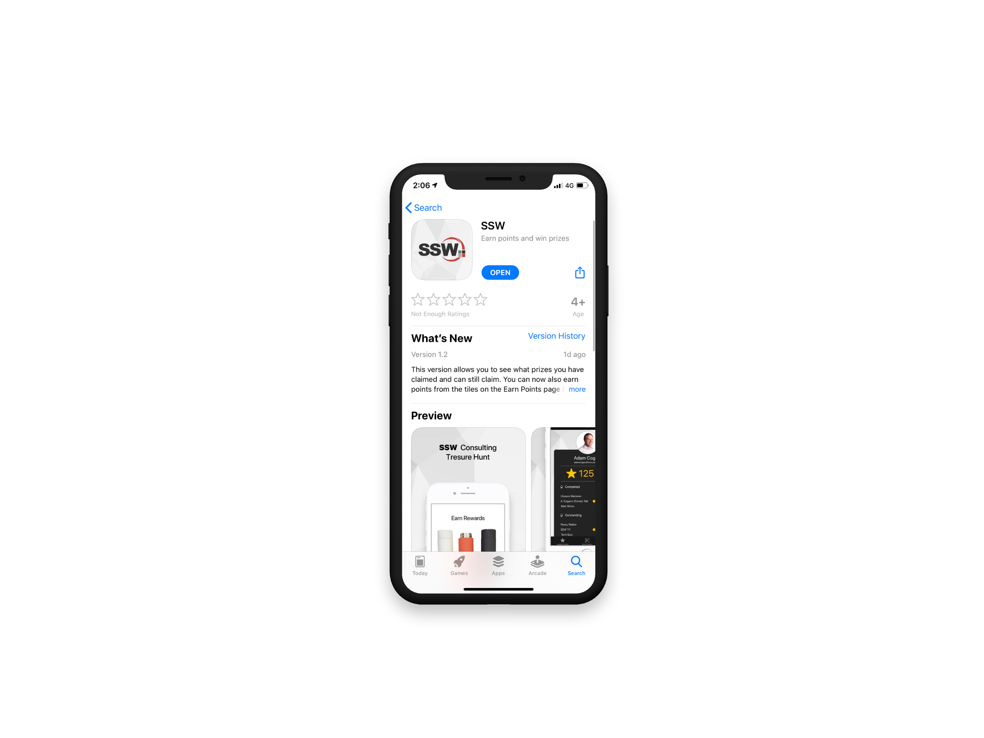

Scan QR Code to install app
Scan SSW codes at talks and events
Earn SSW Points
claim rewards, and win prizes
SSW Rewards
Notes:
An SSW Admin will give you your QR code https://my.sugarlearning.com/SSW/items/13946/ssw-rewards-setup-the-ssw-rewards-app

Slide 6

We’ll cover lots of ground
Whole presentation is in github
Demos are too
I’ll take questions after each demo
https://github.com/brydeno/DatabasePerformance

Slide 7
What are we covering
Improving query performance
Going to be lots of demos
Simple techniques
Where possible we’ll measure the improvement

Slide 8
Useful Tricks
It’s always useful when running locally to get query statistics
Run SET STATISTICS IO ON;
Before you run your query
We’ll see this in the demos ☺
There’s loads more little things littered through the demos

Slide 9
Example database
StackOverflow 2013 database

Slide 10
1. Reduce Table Size
Why
Large tables take longer to read and update
They take up more buffer space

Slide 11
1. Reduce Table Size (What to do)
Archive unneeded data
Reduce column sizes
Remove unnecessary columns

Slide 12
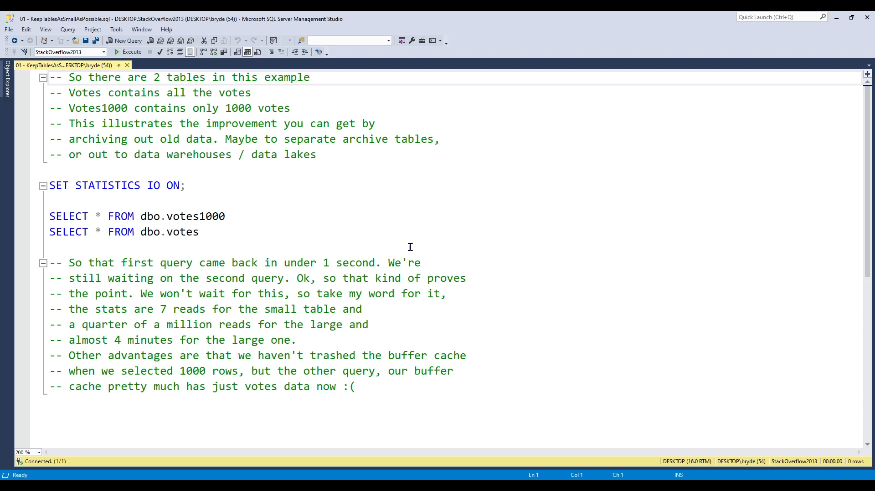

Slide 13
2. Use SELECT <fields> from rather than SELECT * FROM
Retrieving all columns can cause both index and table to be read
Takes more network to transmit
More CPU work at both ends

Slide 14
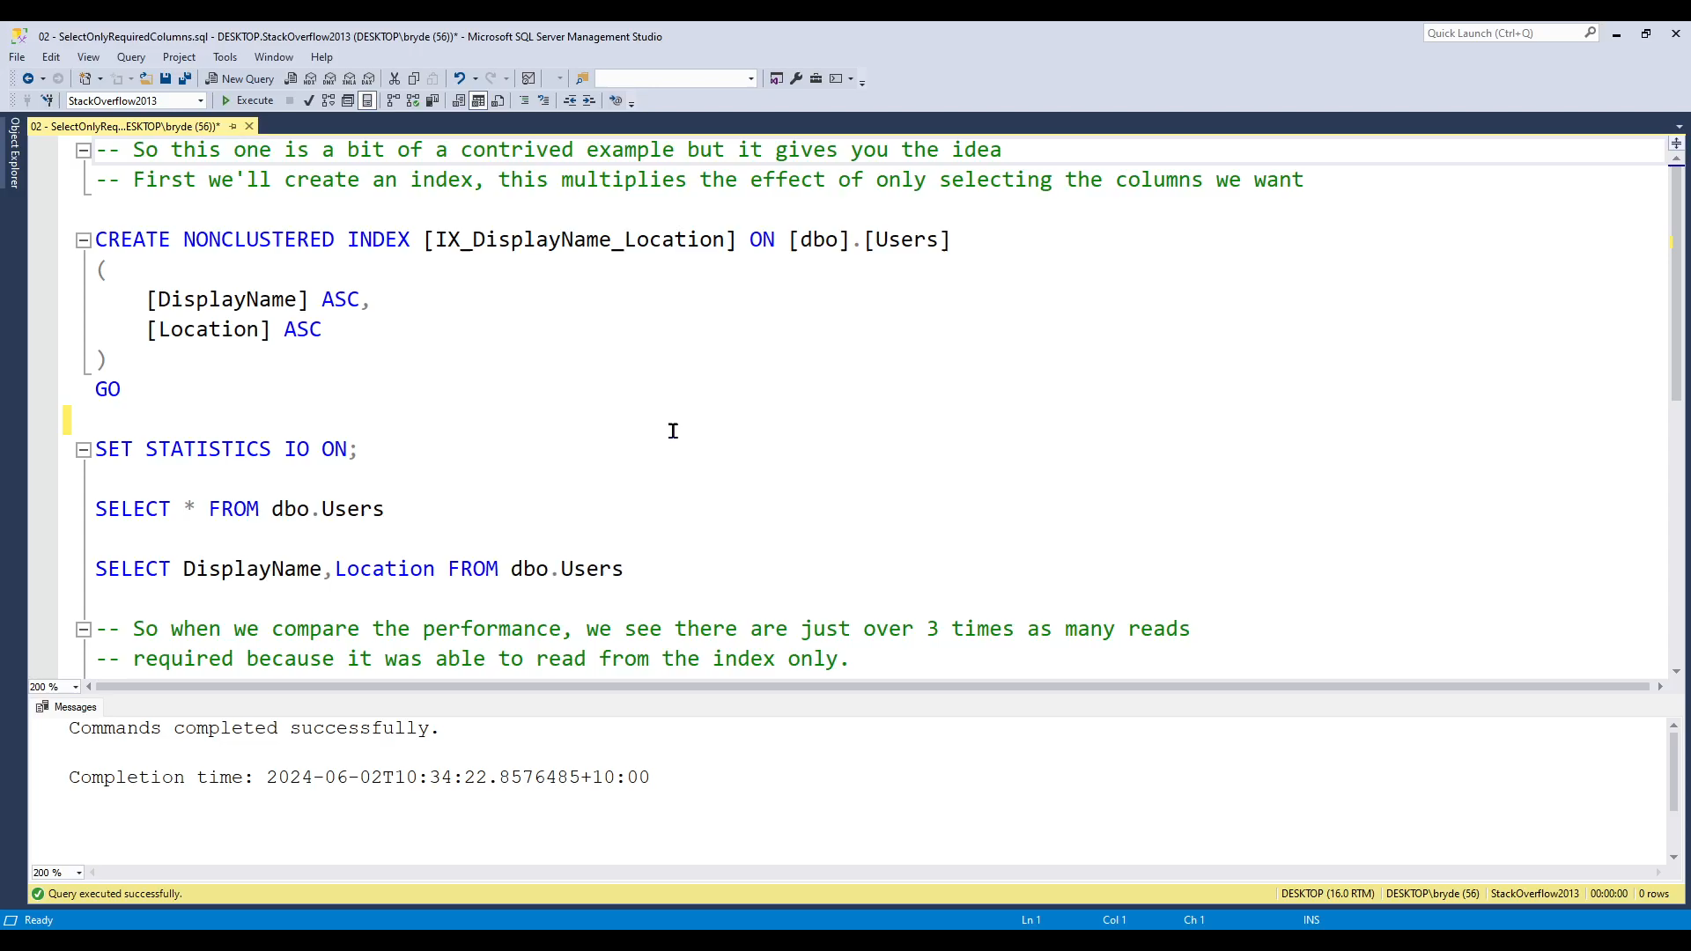

Slide 15
3. Create indexes
Generally gets the biggest wins
Takes some effort
Can make more than 1,000,000 times improvements
https://github.com/brydeno/DatabasePerformance

Slide 16
4. Verify indexes are being used
(Check for unused indexes)
You’d be surprised how often they aren’t
Run your query with “Show Actual Execution Plan” on
Check the plan is what you expect (or better)

Slide 17
DEMO
Execution plan
Unused index query

Slide 18
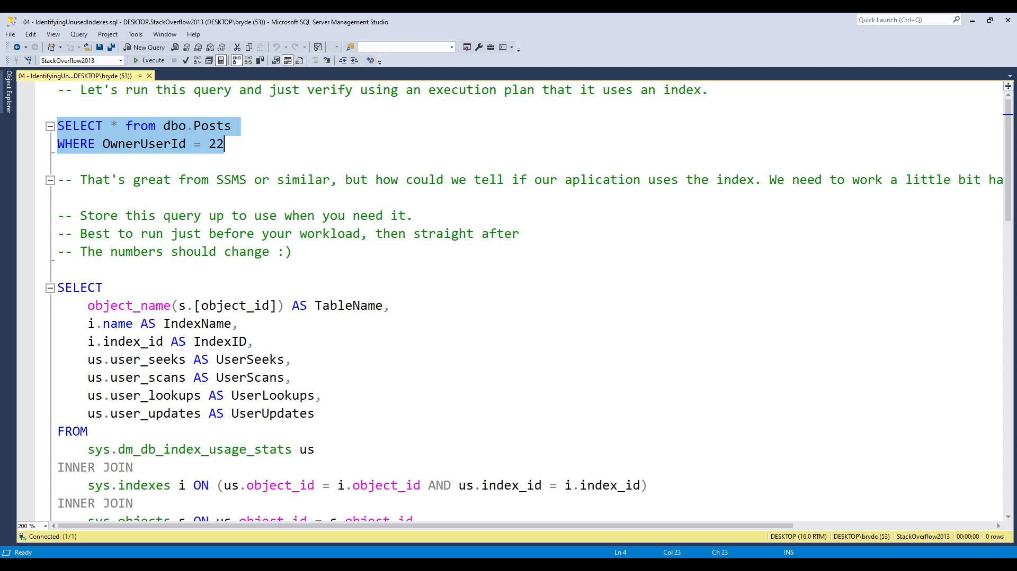

Slide 19
5. Avoid Implicit conversions
Make sure the type in WHERE clause matches column
Can make SQL Server scan a whole index 😱

Slide 20
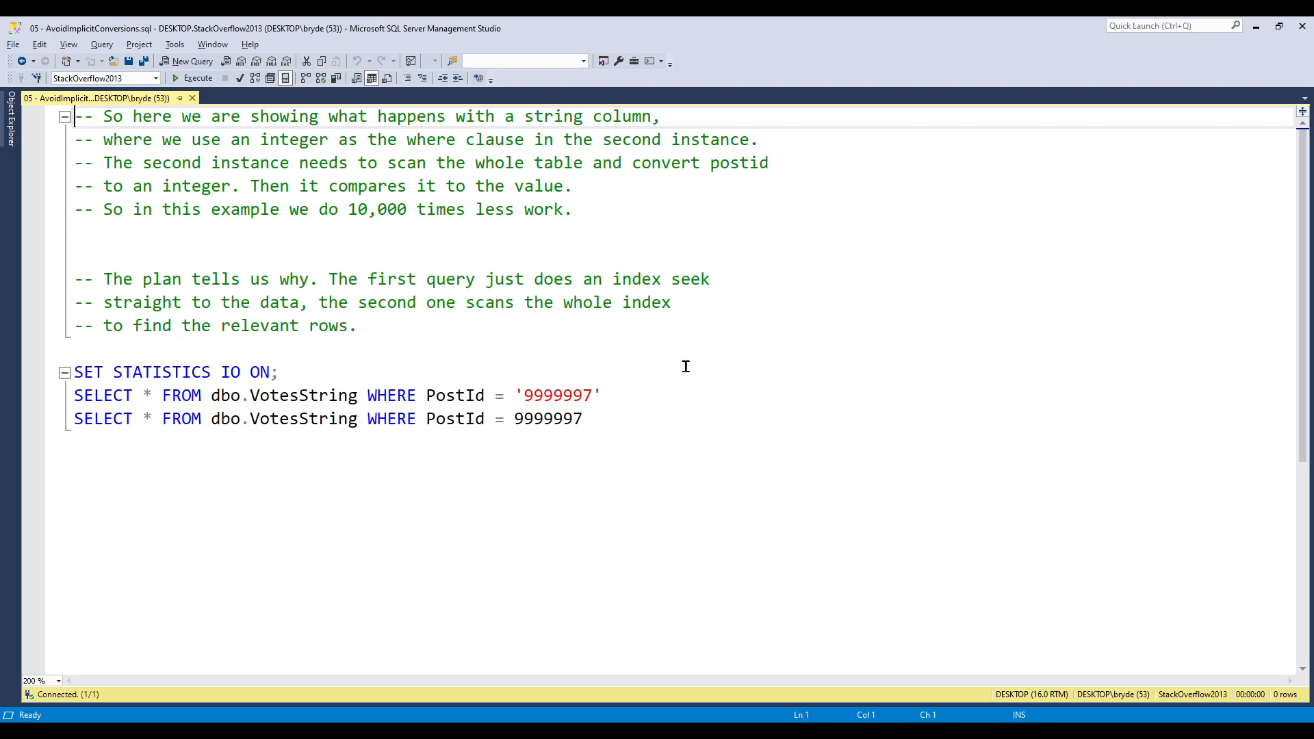

Slide 21
6. Avoid Looping
Looping causes the server to execute one after another
If you can get it to do in parallel much better
Often Group By or aggregation a better choice
There are times looping is necessary.
Looping database statistics is one (very few others).

Slide 22
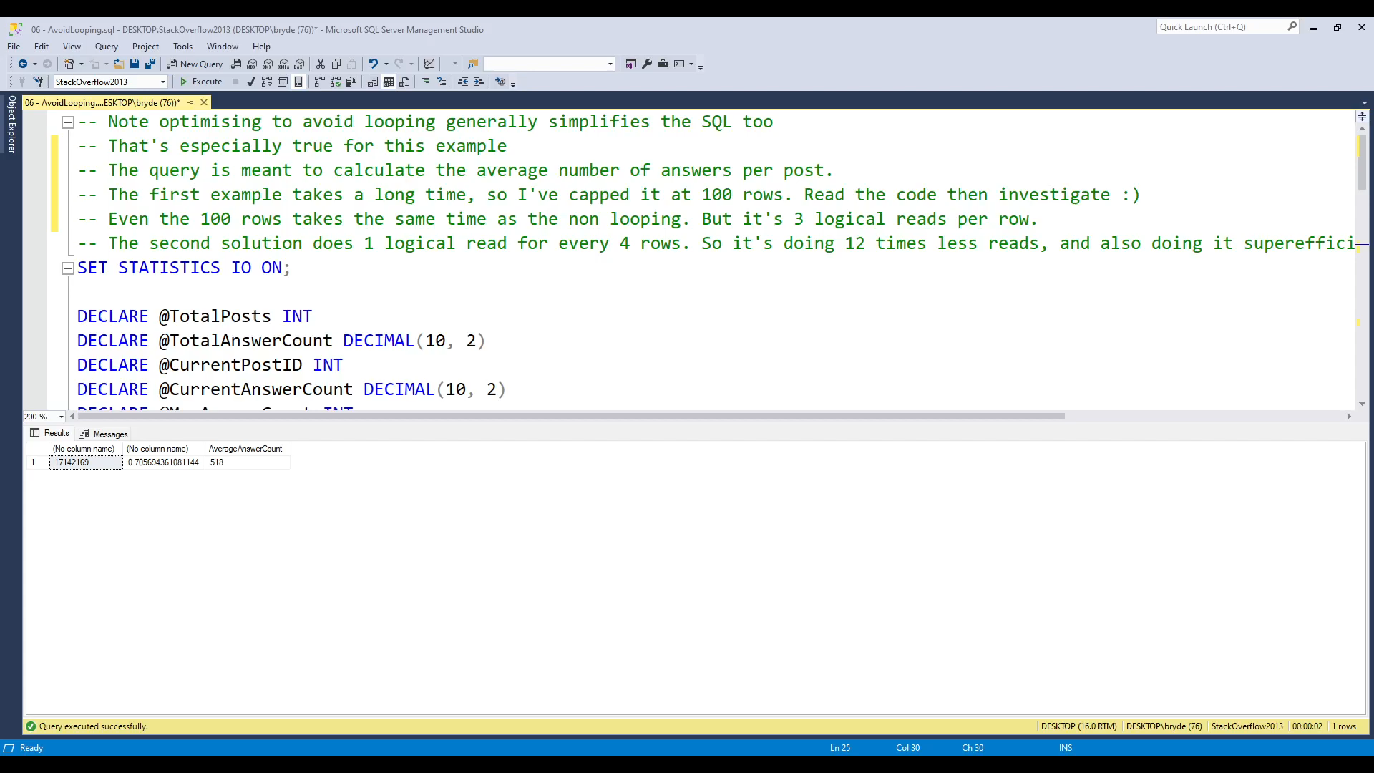

Slide 23
7. Use AND instead of OR where possible
(Or split into 2 queries and UNION the results)
Think through how an OR works, the server needs to traverse both branches of the OR, but typically just scans the whole table
UNION is the most efficient solution, but is much larger to write

Slide 24
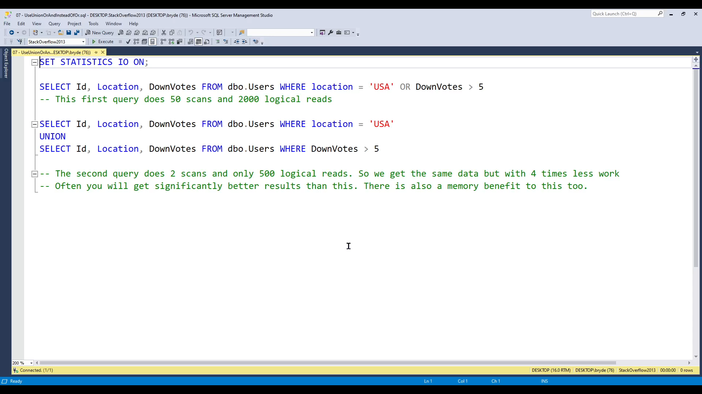

Slide 25
8. Minimize large writes
This one is often caused by the amount of locking that goes on.
Typically using Bulk Insert libraries you can avoid pain here. Be aware that the more foreign keys attached from or to your table, the worse this will get.
Indexes also have significant effect here.

Slide 26
9. Avoid wildcards at the start of string filters
ie don't use LIKE ‘%fred’
For EndWith, reverse the string and index on that…

Slide 27
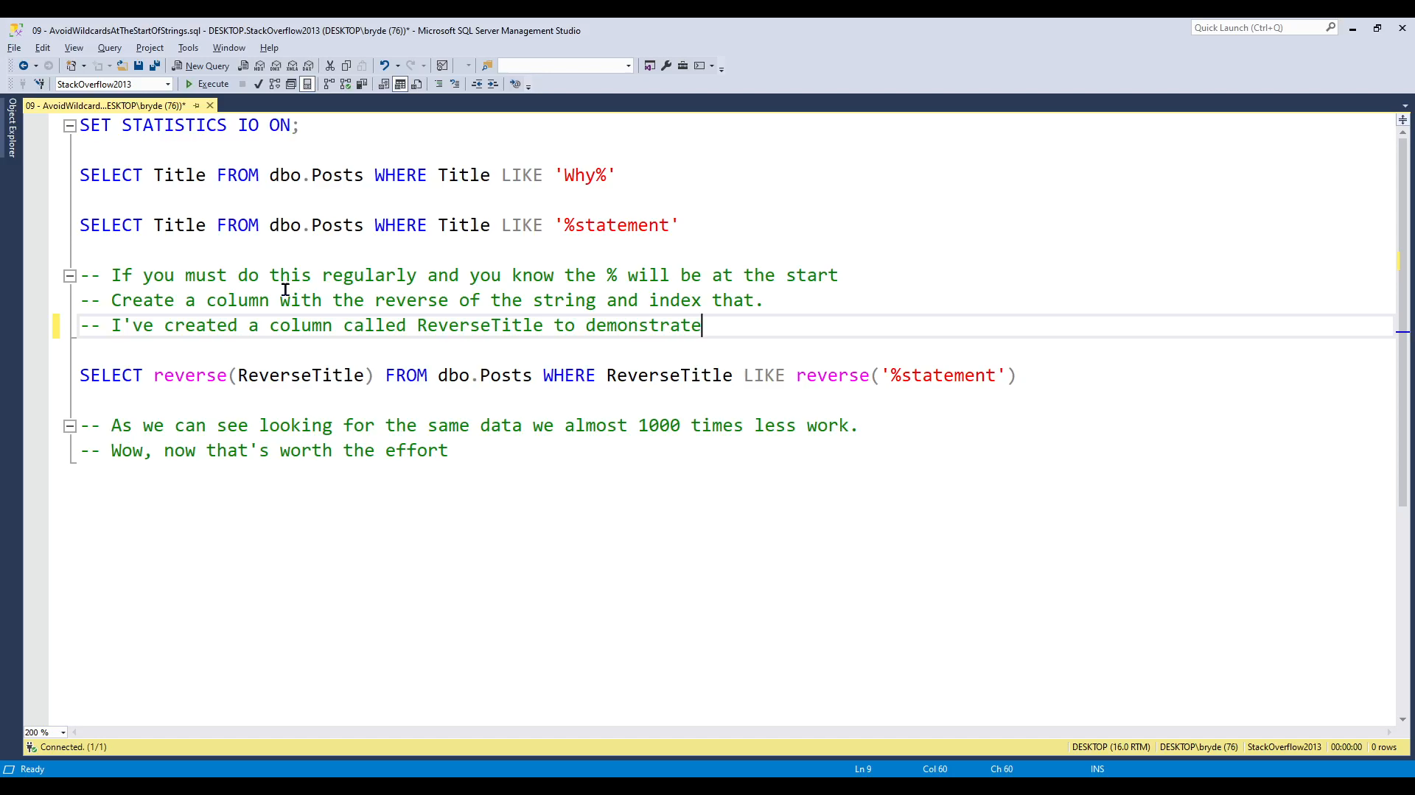

Slide 28
10. Create joins with inner joins not where
Optimizer optimizes JOINs better than WHERE
Can convert most WHERE to JOIN (but not ALL)
Easier to read
Makes it clear what type of JOIN

Slide 29
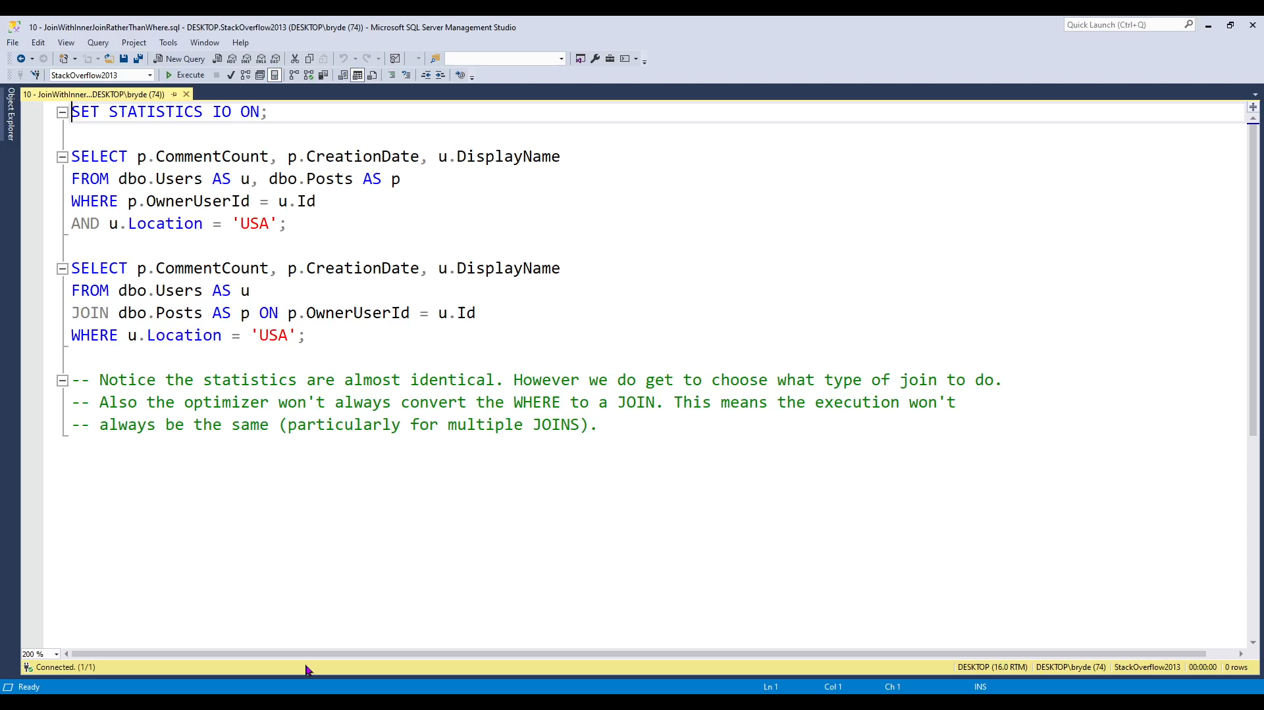

Slide 30
11. Use Exists() instead of count() where you can
Exists() stops as soon as it finds a match
Count() scans to count all the occurrences
Often people write
WHERE count() > 0
WHERE Exists()

Slide 31
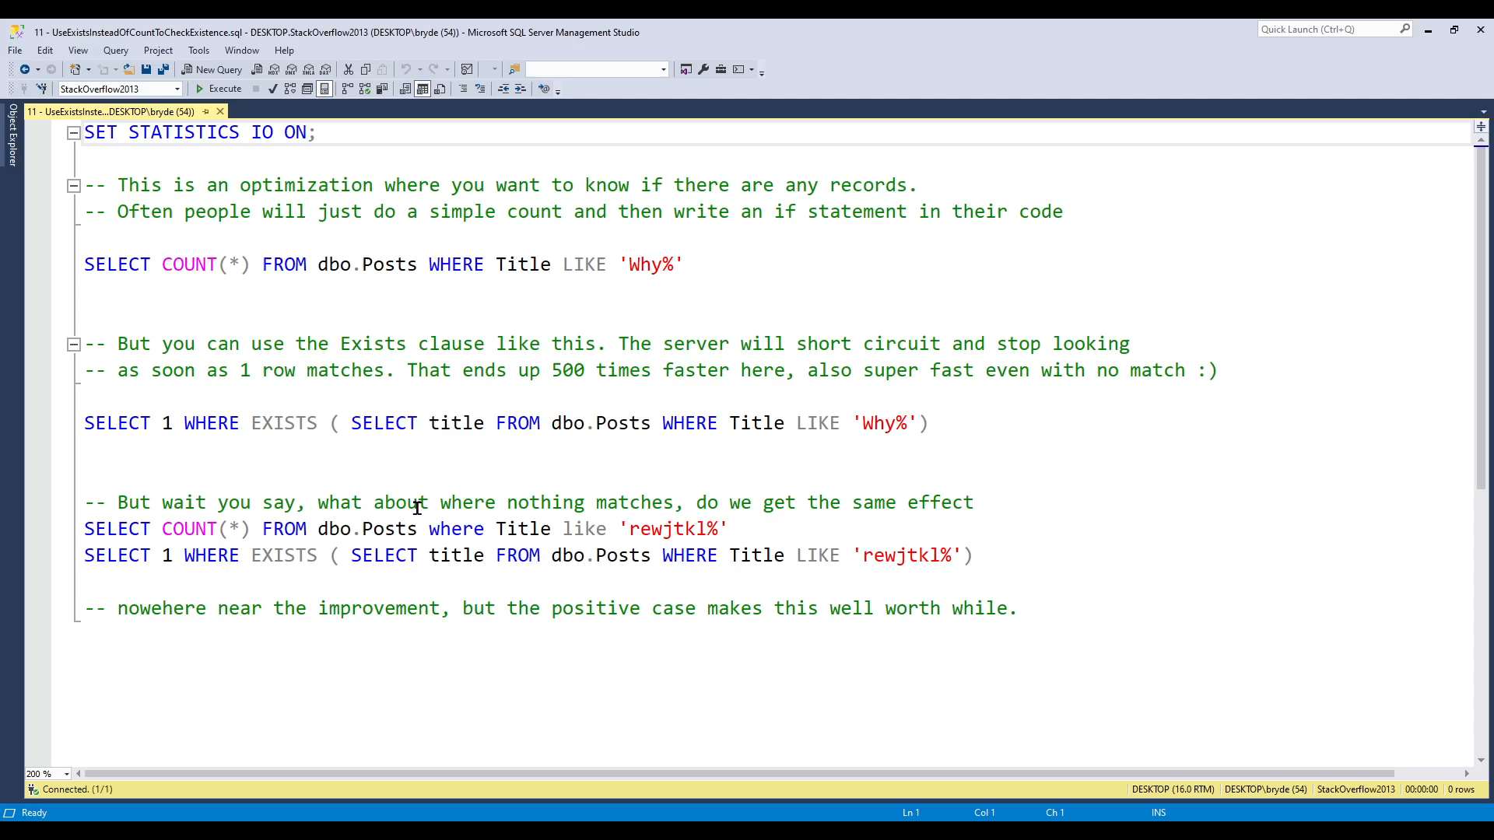

Slide 32
12. Avoid Select distinct
Needs to sort to eliminate the duplicates
May require excessive reading
GROUP BY or more appropriate filtering are better solutions

Slide 33
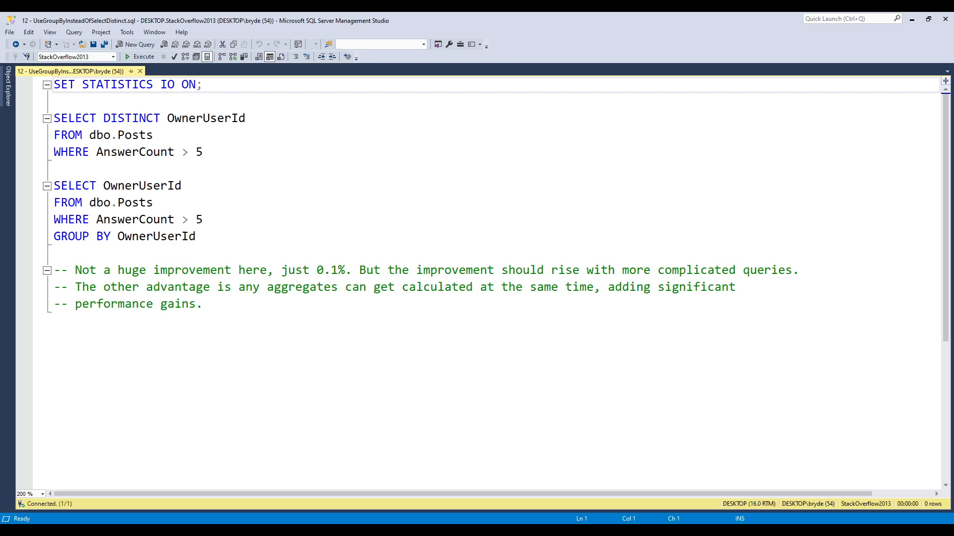

Slide 34
13. Avoid too many joins
While this one is again “it depends”
In general 4-7 JOINS is getting high
Anything more than this will result in the query optimizer struggling significantly.

Slide 35
14. Don't create indexes on tiny tables
If the data fits in a single page, there is no advantage
This is just a small storage optimization, it’s very hard to give a convincing example.
A single page is 8Kb

Slide 36
15. Use TOP for sampling
If you just need to show a few rows as a sample or to verify data. Remember to use TOP to cap the number of rows.
Ie: SELECT TOP 100 * FROM customers

Slide 37
16. Don't index columns that have few unique values
Sometimes… Don’t make it the primary column in the index if there is a less selective….
You want the least selective columns as early as possible in an index…. Remember WHERE and ORDER BY should be separated.

Slide 38
17. Use WHERE instead of HAVING
If you can using WHERE before aggregating is far more efficient than using HAVING after aggregation.
This is because WHERE can take advantage of an index while HAVING cannot.
But they do different things, so often you can’t.

Slide 39

Resources
Brent Ozar
brentozar.com
Pinal Dave:
https://blog.sqlauthority.com/
PASS:
passdatacommunitysummit.com/sessions/video-library/
SQL Skills:
SQL Skills
And loads more, Stack Overflow is also great
The demo database used here (and that lots of SQL demos and courses use) is sourced from: archive.org/details/stackexchange
Brent Ozar keeps a ready to deploy SQL Server database of that, easily downloadable in various sizes for people to learn with. Thanks Brent!!!
Notes:
Tip: Resources indicates that you’re nearing the end of your presentation

Slide 40
Specific further reading
Think like the SQL Server Engine
www.brentozar.com/training/think-like-sql-server-engine/
Sargable Expressions
www.sqlshack.com/how-to-use-sargable-expressions-in-t-sql-queries-performance-advantages-and-examples/

Slide 41




Scan the QR code below and earn
SSW Points for watching this talk!

Slide 42

Got feedback?
Scan the QR code here
to fill our survey.
How to Use this PowerPoint with Adam Cogan

Slide 43

Thank you! info@ssw.com.au www.ssw.com.au Sydney | Melbourne | Brisbane | Newcastle
github.com/brydeno/DatabasePerformance
Notes:
Note: You should say “thank you” and then pause for 4-5 seconds… to give the audience time to applaud!
https://www.ssw.com.au/rules/do-you-finish-your-presentation-with-a-thank-you-slide

Slide 44
Questions? info@ssw.com.au www.ssw.com.au Sydney | Melbourne | Brisbane | Newcastle
github.com/brydeno/DatabasePerformance
Notes:
Note: You should pause for applause here!
https://www.ssw.com.au/rules/do-you-finish-your-presentation-with-a-thank-you-slide

